Slide 1
Evaluation of wind power research in the world
Group 4

Slide 2
Historical background
Since early recorded history, people have harnessed the wind energy. It propelled boats along the Nile River as early as 5000 B.C. By 200 B.C., simple windmills in China were pumping water, while vertical-axis windmills with woven reed sails were grinding grain in Persia and the Middle East.
New ways of using the this energy eventually spread around the world. By the 11th century, people in the Middle East used windmills extensively for food production. Returning merchants and crusaders carried this idea back to Europe. The Dutch refined the windmill and adapted it for draining lakes and marshes in the Rhine River Delta. When settlers took this technology to the New World in the late 19th century, they began using windmills to pump water for farms and ranches and later to generate electricity for homes and industry.
American colonists used windmills to grind wheat and corn, to pump water and to cut wood at sawmills. With the development of electric power, wind power found new applications in lighting buildings remotely from centrally generated power. Throughout the 20th century, small wind plants, suitable for farms and residences, and larger utility-scale wind farms that could be connected to electricity grids were developed.

Slide 3
During World War II, the largest wind turbine known in the 1940s, a 1.25-megawatt turbine that sat on a Vermont hilltop known as Grandpa’s Knob, fed electric power to the local utility network. Wind electric turbines persisted in Denmark into the 1950s but were ultimately sidelined due to the availability of cheap oil and low energy prices.
The oil shortages of the 1970s changed the energy picture for the world. It created an interest in alternative energy sources, paving the way for the re-entry of the wind turbine to generate electricity.
From 1974 through the mid-1980s, countries have worked to advance the technology and enable development and deployment of large commercial wind turbines. Large-scale research wind turbines were developed under a program overseen by NASA to create a utility-scale wind turbine industry in the United States. With funding from the National Science Foundation, 13 experimental turbines were put into operation using four major wind turbine designs. This R&D program pioneered many of the multi-megawatt turbine technologies in use today. The large wind turbines developed under this program set several world records for diameter and power output.

Slide 4
In the 1980s and early 1990s, low oil prices threatened to make electricity from wind power uneconomical. But in the 1980s wind energy flourished because of tax incentives that encouraged renewable energy sources. These incentives funded the first major use of wind power for utility electricity. The turbines, clustered in large wind resource areas such as Altamont Pass, would be considered small and uneconomical by modern wind farm development standards.
While wind energy’s growth in the U.S. slowed dramatically after tax incentives ended in the late 1980s, wind energy continued to grow in Europe, in part due to a renewed concern for the environment in response to scientific studies indicating potential changes to the global climate if the use of fossil fuels continues to increase.
Today, wind-powered generators operate in every size range, from small turbines for battery charging at isolated residences to large, near-gigawatt-size offshore wind farms that provide electricity to national electric transmission systems. To see the history of wind farm growth in the United States, watch the U.S. Department of Energy’s timelapse graphic.

Slide 5
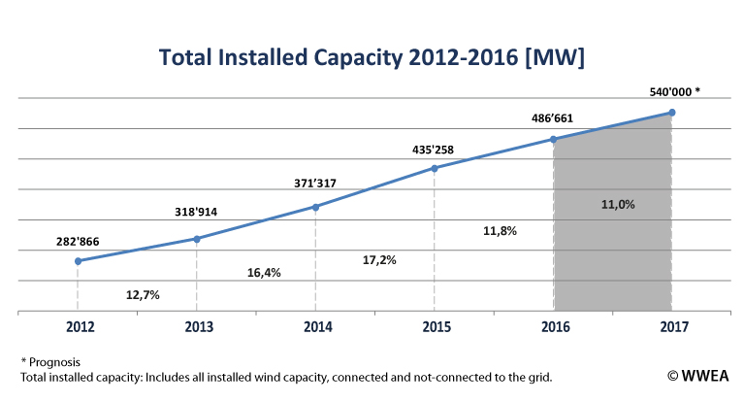
Current production
The worldwide wind capacity reached 486,661 MW by the end of 2016, out of which 54’846 MW were added in 2016. This represents a growth rate of 11.8 % (as compared to 17.2 % in 2015).
All wind turbines installed worldwide by the end of 2016 can generate around 5 % of the world’s electricity demand.

Slide 6
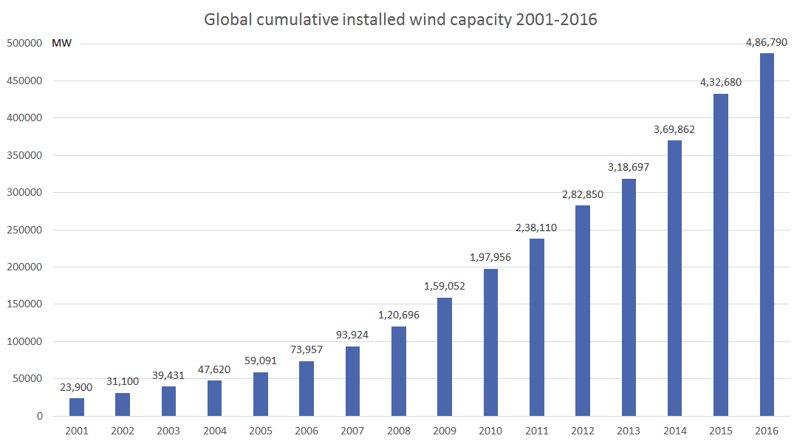

Slide 7
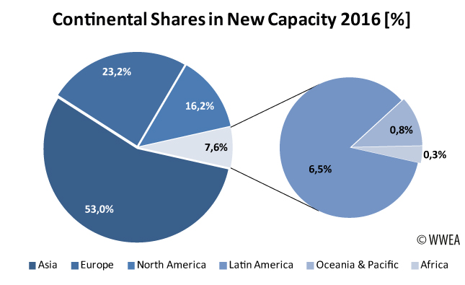
China and Latin America have increased their share of new installations to 53 % and 6.5 % respectively.

Slide 8
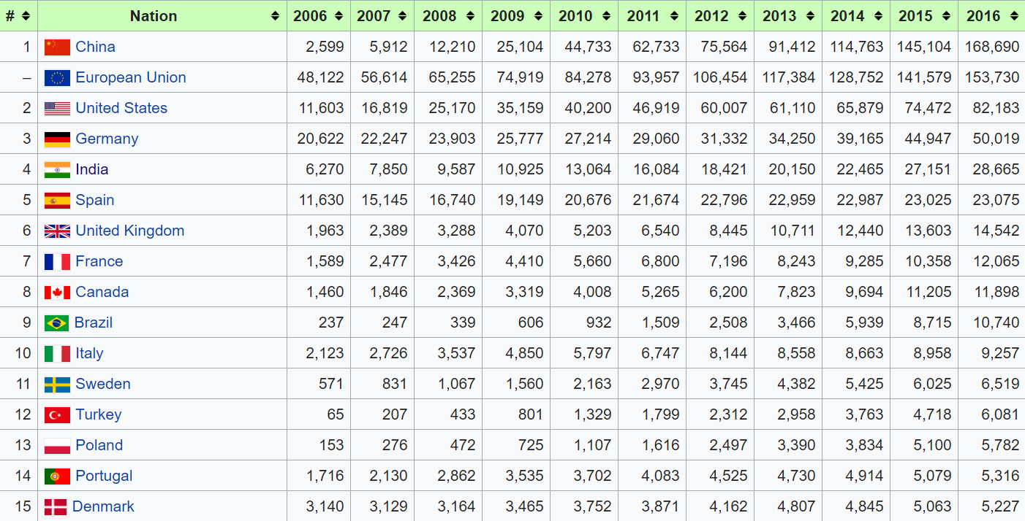
Wind Production by country

